Slide 1
Hive Wars
April 28th, 2009
Josh Bruno, Aaron Murdoch, Zain Rizvi

Slide 2
Overview
Game Details
Problem Description
Alternative Solutions
Selected Solution
Implementation
Demonstration

Slide 3
Game Details
Real Time Strategy
Two Players
Communication over the Internet

Slide 4
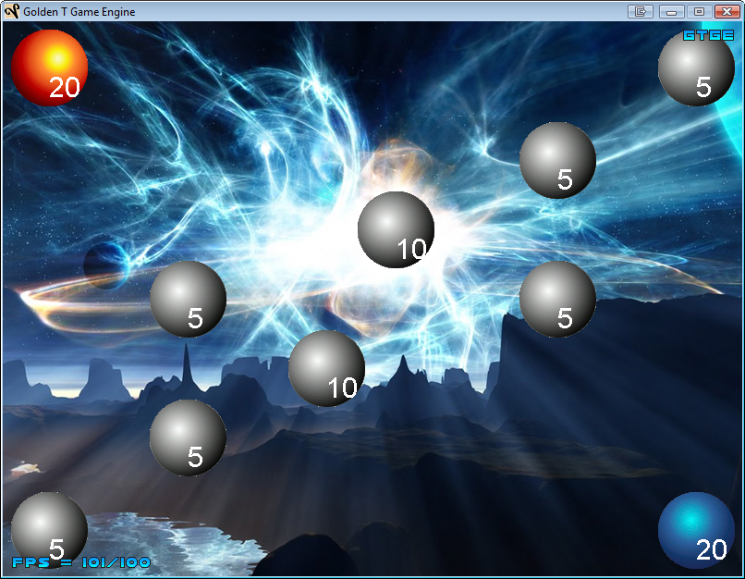
Game Play
Goal: eliminate the other player
Each person starts off with one hive

Slide 5
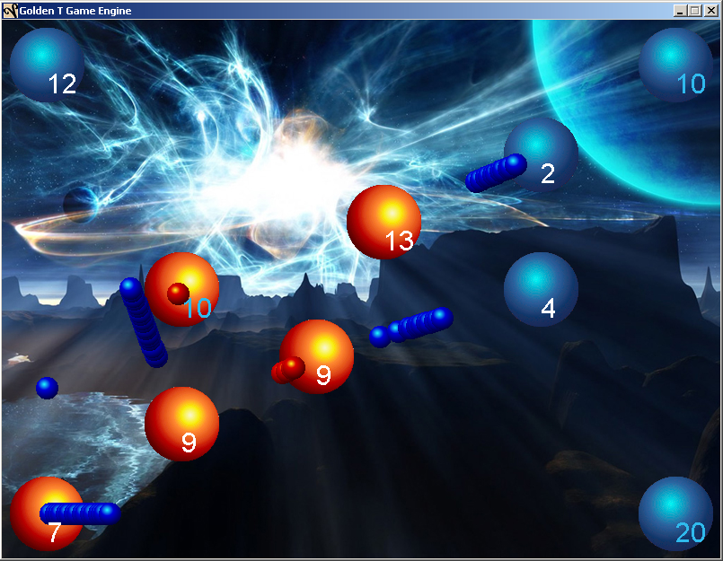
Game Rules
Capture enemy hive by sending minions to it
Can send one minion every 0.1 seconds
Can send minions to your own hive to reinforce it

Slide 6
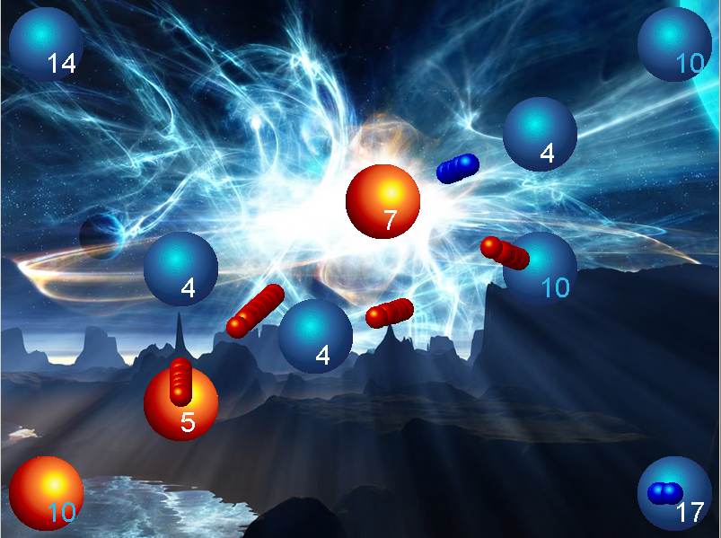
Game Constraints
Each hive has its own:
minion spawn rate
maximum capacity
Hive can never surpass max capacity

Slide 7
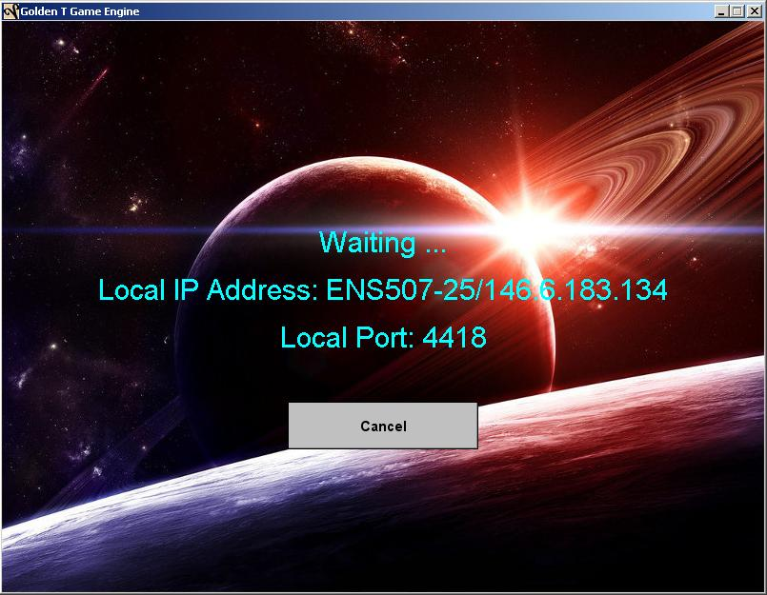
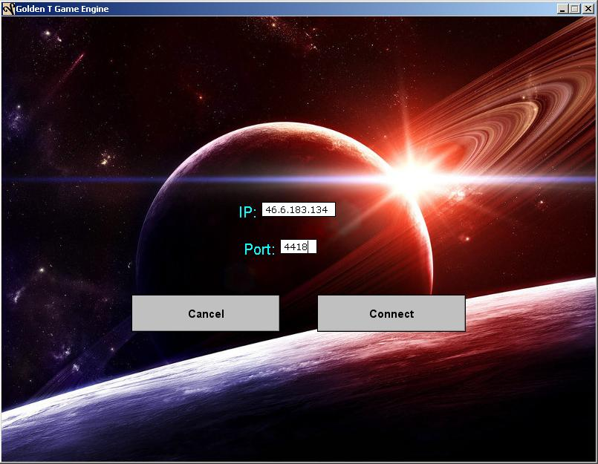
Connecting to your Opponent

Slide 8
Problem Description
Consistent Game State
No game state divergence
Speed
Fairness
Playable with 500ms latencies

Slide 9
Game State Divergence

Slide 10
Alternative Solutions
Central Server
Central Referee
Asynchronous

Slide 11
Central Server
All Messages through Central Server
Consistent Game State Saved On Server
Violates Fairness and Speed

Slide 12
Central Referee
Clients communicate with each other
Send a copy of each state to referee
Referee solves disputes
Violates speed

Slide 13
Asynchronous
Clients communicate directly
Algorithm saves a concurrent state
No recovery from divergence

Slide 14
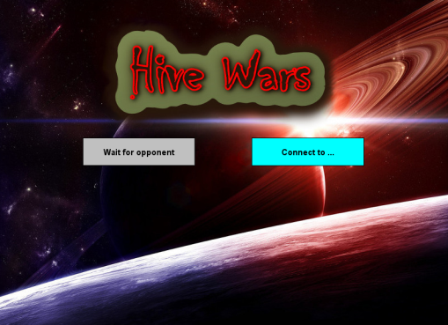
Implementation
Game Controller
Clock
Receive
Reconcile
GUI
Viewable GameState
Master GameState
Notes:
Decentralized Fair Multiplayer Online Read Time Strategy game
When the game is started GameController spawns the gui thread and the receive thread and then waits for the game to start
Gui takes the user through a menu and once the user tells connects to another player the gui alerts game controller and the game starts
Once the game starts game controller spawns a clock thread every 100ms which updates the viewable game state

Slide 15
GameState
GameState Number
ArrayList of Attacks
HashMap of Hives
Master vs. Viewable
Protected by Semaphores
Viewable GameState
Master GameState
Notes:
The game state variables store the game state number
An array list of attacks and a hash map of hives.
The gamestate number is essentially a logical clock used to keep the two players in sync with each other
Attacks stores all the attacks currently on the screen and hives keeps track of who ones what and how many minions are in each hive
There are two Game State variables

Slide 16
GUI
Displays Current Viewable GameState
Records Attacks
Viewable GameState
GUI
Game Controller
New Attack

Slide 17
Clock
Checks Master GameState Number
Adds New Attack to the Viewable GameState
Transmits Current Viewable
Game Controller
Clock
Viewable GameState
New Clock Thread Started
Every 100 ms
Transmit Viewable

Slide 18
Receive
Receives Opponents GameState
Reconcile
Updates Master GameState
Add Opponents Attacks to Viewable
Receive
Reconcile
Master GameState
Viewable GameState

Slide 19
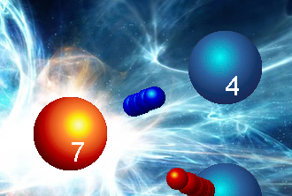
Concurrency
Lag Timer
Distance Between Hives
150 pixels

Slide 20
Implementation
Game Controller
Clock
Receive
Reconcile
GUI
Viewable GameState
Master GameState
Spawns Threads
Stores
New Attacks
Every 100 ms
Adds New
Attack to
Viewable
Transmits
Viewable
Opponent
GameState
Displays
Viewable
Updates
Master and Viewable

Slide 21



Development Details
Golden T Game Engine
Subversion
Google Code

Slide 22
Conclusion
Real Time Strategy
Multiplayer Over the Internet
No Central Server
Fair Game-play, No Divergence, and Speed

Slide 23
Demonstration
http://code.google.com/p/hivewars/ or google “hivewars code”
April 28th, 2009
Josh Bruno, Aaron Murdoch, Zain Rizvi

